Slide 1
Organic Farming
Skill Enhancement Course (SEC)
Department of Botany
Daulat Ram College
University of Delhi

Slide 2
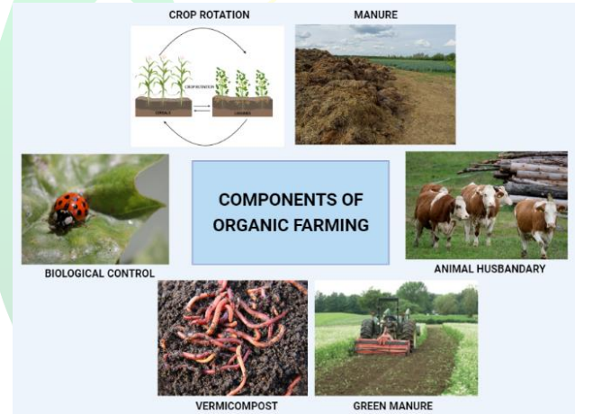
Introduction
Organic agriculture is an integrated production management system which promotes and enhances agro-ecosystem health, including biodiversity, biological cycles and soil biological activity.
It emphasizes the use of natural inputs (i.e. mineral and products derived from plants) and the renunciation of synthetic fertilizers and pesticides.

Slide 3
Advantages of organic farming
Sustainable Agriculture
Reduces the cost of agricultural production
Optimum utilization of natural resources
Maintain environment health
It improves the soil physical and chemical properties

Slide 4
Eligibility Criteria
Any Ist year enrolled in Bachelor course
Who can opt this
Pre-requisities
No specific pre-requisities
However, Prior knowledge to Plants and Chemical handling will be nice

Slide 5
Learning Outcomes:
Get opportunity to make career in developing kitchen gardens, organic fertilizers, vermicompost and organic food manufacture
Practice organic farming along with application of indigenous knowledge.
Evaluate the organic produce as per fssai standards (government rules).
Establish entrepreneurial ventures and generate employment (organic grower).

Slide 6
THANK YOU
Questions are welcome!

Slide 7
DEPARTMENT CHEMISTRY

Slide 30
Department Commerce

Slide 31
DIGITAL MARKETING Skill Enhancement Course
Presented By
Dr Renu Yadav
Assistant Professor

Slide 32
What is Digital Marketing.
Digital marketing, also called online marketing, is the promotion of brands to connect with potential customers using the internet and other forms of digital communication. This includes not only email, social media, and web-based advertising, but also text and multimedia messages as a marketing channel.
It teaches you how to build, scale up, and sustain your Brand’s online reputation across all relevant Digital platforms (which is known as Online Reputation Management). Nowadays, businesses thrive on online presence, reviews, and customer testimonials.

Slide 33
Learning Objectives: To acquaint the knowledge of growing interaction between the traditional and digital marketing concepts and practices in the digital era. To familiarize with the tools and techniques by the digital marketers.
Learning Outcomes:
Better understanding about the concept of digital marketing and its integration with traditional marketing.
Understanding about customer value journey in digital context and behavior of online consumers.
Get knowledge about different tools and tactics for enhancing a website’s position and ranking with search engines.

Slide 34
Course Structure (2 Credit Course)
Unit 1: Marketing in the digital Marketing
Unit 2: Content and Email Marketing
Unit 3: Social Media marketing and Display Marketing
Unit 4: Search Engine Marketing

Slide 35
Digital Marketing Career Opportunities
One of the reasons a digital marketing career is so exciting is that because the field is constantly evolving as different platforms are introduced. A digital marketing manager is always scoping out trends and seeing how they impact discoverability.
Building experience in digital marketing encompasses just about every facet of a brand’s presence online. As search engines roll out new updates, digital marketing managers determine how they impact website rankings. From there, the entire marketing team works together to create a strategy.
Thank You

Slide 36
Presentation on Innovation and Entrepreneurship (SEC Paper)
Presented by:
Mrs .Mansi Kanojia
Assistant Professor
Department of Commerce

Slide 37
Objective
Encourage the process of creative thinking and innovation
Build an entrepreneurial perspective to identify and tackle problems and explore new opportunities
Gain insight into building business models and plans
Identify tools and strategies that entrepreneurs may use for start-up, innovation and reinvention
Understand how to go from an idea to product and scale it up for sustainability
Develop skills to work in teams and build connections, collaborations and social networks .
Outcome
Identify and comprehend the concepts of creativity, innovation and invention in various contexts.
Enrich their theoretical and conceptual foundations in entrepreneurship.
Gain hands-on experience that shall empower them to identify business and social opportunities and venture in the entrepreneurial landscape.
Prepare themselves to take informed decisions in establishing start-ups and ongoing innovation in organisations.

Slide 38
Syllabus
Unit I: Understanding Creativity
Unit II: Ideation
Unit III: Understanding the business
Unit IV: Venturing Forth

Slide 39
Personal Financial Planning
By Ms. Ritu Rani
Assistant Professor
Department of Commerce
Daulat Ram College, University of Delhi

Slide 40
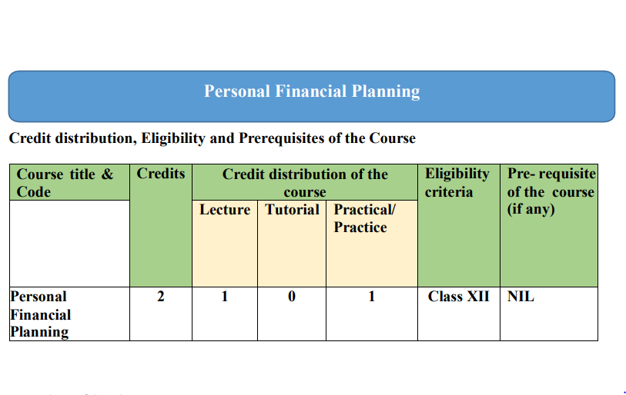

Slide 41
Syllabus
Unit 1: Introduction to Financial Planning
Unit 2: Investment Planning
Unit 3: Personal Tax Planning
Unit 4: Insurance Planning
Unit 5: Retirement Benefits Planning

Slide 42
Personal Financial Planning
It is the process of planning your spending, financing and investing to optimize your financial situation.
An understanding of personal finance is beneficial to you in many ways :

Slide 43
Make your own financial decisions :-
The specific advantages of personal financial planning include
Increased effectiveness in obtaining, using and protecting your financial resources throughout your lifetime.
Increase control of your financial affairs by avoiding excessive debt, bankruptcy and dependence on others for economics security.
Improved personal relationship resulting from well-planned and effectively communicated financial decisions.
Essence of freedom from financial worries obtained by looking to the future, anticipating expenses and achieving your personal economic goals.
Enhance the quality of your life and increase your satisfaction by reducing uncertainty about your future needs and resources.

Slide 44
Judge the advice of Financial Advisors
The personal financial planning process will enable you to make inform decisions about your spending, saving, financing and investment.
Neverthless, you may prefer to rely on advice from various types of financial advisors.
An understanding of personal finance allow you to judge the guidance of financial advisors and to determine whether the advice is in your best interest (or in their best interest).

Slide 45
Become a Financial Advisor
An understanding of personal finance may interest you in pursuing a career as a financial advisor.
Financial Advisors are in demand because many people lack an understanding of personal finance or are not interested in making their own financial decisions.

Slide 46
Objectives
The Learning Objectives of this course are as follows:
To familiarize with different aspects of personal financial planning like
Savings,
Investment,
Taxation,
Insurance, and
Retirement Planning
To develop the necessary knowledge and skills for effective financial planning.

Slide 47
Outcomes
After studying this course,
You will be able to understand the meaning and appreciate the relevance of financial planning.
You will be able to understand the concept of investment planning and its methods.
You will be able to examine the scope and ways of personal tax planning.
You will be able to analyse insurance planning and its relevance.
You will be able to develop insight into retirement planning and its relevance.

Slide 48
THANK YOU !!

Slide 49
SKILL ENHANCEMENT COURSE (SEC)PAPER OFFERED BY COMMERCE DEPARTMENT

Slide 50
SCOPE OF PAPER

Slide 51
I. Introduction, Financial Planning and Budgeting

Slide 52
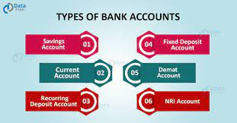
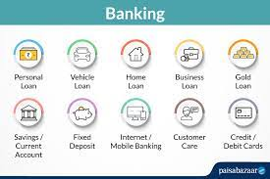
II. Banking Services

Slide 53
III. Services Offered By Post Offices

Slide 54
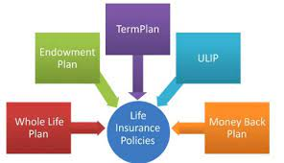
IV. Insurance Services

Slide 55
V. Stock Markets- Basic Concepts

Slide 56
Teaching Learning Process
Case Study
Movies and Shows
Study Material
Practical Approach
Bilingual

Slide 57
Outcome and Prospects
Finance Is Ubiquitous as it complements various disciplines such as Science, Economics, Political Science etc.
Finance Will Help Your Resume Stand Out
Financial education is essential for a successful life as Finance Industry is Constantly Evolving eg: payment technology, cryptocurrency
Knowledge of Finance helps in adapting and conquering in global market
Finance teaches you the difference between price and value
It helps to analyse understand and the benefits of various finacial schemes for tax saving purposes
It provides an edifice for careers in Finance such as Portfolio Management, Risk Management, Banking Jobs etc. which are well paid and in-demand
Fosters the pace of Financial Inclusion

Slide 58
THANK YOU

Slide 59
Advanced Spreadsheet TOOLS UPC: 2346000001
Dr. Shivani Bansal
Assistant Professor
Daulat Ram College
University of Delhi

Slide 60
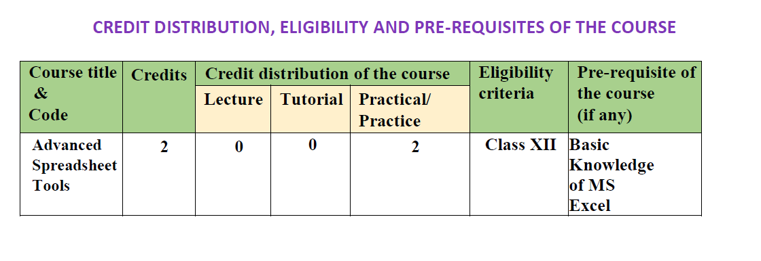
> Basic Ms- Excel knowledge is needed.
> 2 practicals translate to 4 hours of hands on practice class.

Slide 61
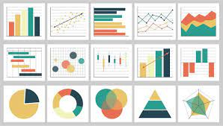
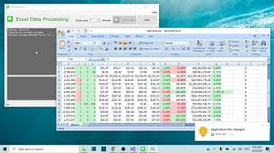
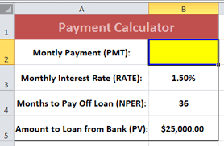
Learning Objectives and Outcomes
Advanced Data Analysis, Charts, Pivot Tables representation
Dynamic and Real Time representation of Data- Power BI Dashboards
Automation on excel, queries, macros, forms and Reports
Automation of Routine Tasks, Offsetting Errors
Solving Financial and Statistical problesms
Capital Budgeting, Resource Optimisation Problems, Transport Cost effectiveness

Slide 62
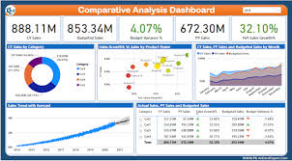
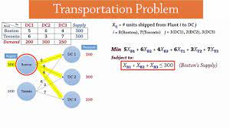

Slide 63
Practical usage ….where to apply the knowledge
Excel is quintessential in all industries/ business
Improves efficiency of work
Quick Problem solving in business
Automating routine work
Creation of better and interactive/dynamic presentations
Statistical and financial analysis

Slide 64
1. Continuous evaluation: 20 marks (CLASS PARTICIPATION, PROJECT WORK, PRESENTATIONS, DASHBOARD PREAPRATION, ASSIGNMENT QUESTIONS FOR PRACTICE) 2. end term practical exam: 40 marks 3. viva VOCE: 20 marks
Assessment Scheme
( As per Latest University Guidelines)

Slide 65
THANK YOU
Questions are welcome!

Slide 66
YOGA IN PRACTICE
DEPARTMENT OF COMMERCE
DR. GEETA CHAUHAN

Slide 67
YOGA - Meaning
The word YOGA has been derived from the Sanskrit word “YUJ” which means “TO YOKE” or “To JOIN” or “To UNITE” the spirit and physical body together.
As per the Yogic scriptures the practice of Yoga leads to the union of individual consciousness with that of the Universal Consciousness, indicating a perfect harmony between the mind and body, MAN & Nature.

Slide 68
SYLLABUS & LEARNING OUTCOMES
Broad topics covered are:
Yoga: Types of yoga; Ashtanga Yoga; Chakras
Asanas and their advantages
Pranayama
LEARNING OUTCOMES
Understanding the concept and various aspects of the science of yoga.
Theoretical & practical knowledge os asanas and pranayama
Understanding the ways to harmonise the body and mind
Understanding the consciousness and disciplining the mind through practicing yoga

Slide 69
CAREER PROSPECTS
By seeing the benefits of Yoga, career opportunities in fitness field are increasing in India as well as abroad. Job opportunities as a Yoga Practitioner; Yoga & Aerobic Instructor; Yoga Therapist; Yoga consultant or Advisor in the given fields such as Research; Management; Hospitals; Academic, Administrative; consultation etc.
Examples:-
Schools and Yoga & Naturopathy Colleges/Institutions
Health Clubs/ Hospitals
Yoga & Pilates Studios
Special Needs Centre
Hotels & Resorts
Private Gym

Slide 70
THANK YOU

Slide 71
Daulat Ram College
University of Delhi
SEC Orientation 2023

Slide 72
SEC PAPER 2023-2024
Business Communication
Presented By:
Jyoti Mahlawat
Assistant Professor
Department of Commerce
Daulat Ram College.
TIC 2023-24:
Dr. Reema Dehal
Associate Professor
Department of Commerce
Daulat Ram College.

Slide 73
Content of the Course:
Introduction to the essentials of Business Communication
Effective Writing
Report Writing
Business Correspondence and E-Correspondence
Spoken English and Oral
Presentation

Slide 74
Significance of the course
To train students to enhance written as well as oral communication in the corporate world.
To help students in understanding the principles and techniques of business communication.
Business communication contributes to the development of an ability to influence others.
In creating and maintaining professional relationships.

Slide 75
➢ Explain the need for communication in
management.
➢ Appreciate the need of effective writing
for communication.
➢ Demonstrate the skill of effective report
writing and summarizing annual reports.
➢ Analyze business correspondence and e-correspondence.
➢ Appreciate oral presentations. prepare a
financial plan, budget and manage
personal finances
Takeaways:

Slide 76
Thank You!!

Slide 77
DEPARTMENt ECONOMICS

Slide 78
BASIC IT TOOLS
Course Outcome
Hands-on training and in-depth knowledge of Microsoft Office Softwares: MS Word, MS Excel and MS Access.

Slide 79
IMPORTANCE OF THIS PAPER
MS word is essential for submission of assignments and projects in higher education.
Learning MS EXCEL is vital for data analysis, interpretation and visualization,
Database management (MS ACCESS) has direct linkage with your future prospects in the job market as we all know “data is the new oil”.

Slide 80
LEARNING OUTCOME
Enhanced knowledge about the tools used In every Sector for Maintaining Data Files, Documenting Information, Formatting, Protecting, Presenting And Analyzing Data.
The aura of Information Technology (IT) can be seen in almost all fields including work, learning, leisure, and health. This paper will enhance the employability skills of the students.

Slide 81
WHO SHOULD STUDY THIS PAPER
This course is essential for students who have no or very less knowledge about the MS Office Suites.
Basic understanding of MS Excel and Word is a pre-requisite for studying some of the other advanced SEC papers.

Slide 82
Data Analyst | Database Administrator
Project Manager | Business Analysts
Financial Analysts | Accountants
Retail Store Managers | Court Reporter
JOB OPPORTUNITIES
Secretary
Typist

Slide 83
Department English

Slide 84
PERSONALITY DEVELOPMENT AND COMMUNICATION Department of English, Daulat Ram College
Skill Enhancement Course (SEC)

Slide 85
CREDIT DISTRIBUTION, ELIGIBILITY AND PRE-REQUISITES OF THE COURSE
Course title & Code | Credits | Credit distribution of the course | Eligibility Criteria | Pre-requisite of the course (if any)
Personality Development and Communication | 2 | Lecture- 1 Practical- 1 Tutorial- 0 | Class XII | NA

Slide 86
Learning Objectives
To develop inter-personal and effective communication skills.
To develop problem solving skills and understand its influence on behavior and attitudes of individuals.
Learning Outcomes
Understanding of the importance of oral and written communication in day-to-day working of the organization.
Understanding of the role of body language in effective communication.

Slide 87
Course Contents
Unit 1
Introduction
Communication- Need, Process, and Types
Business letter writing
Silence as a mode of communication
Communication through questionnaire
Unit 2
Business Cases and Presentations
Letter Writing
Circulars and Memos
Report writing
Use of audio-visual aids

Slide 88
Unit 3
Barriers to Communication
Non-verbal communication- Body language, body posture, gestures, value of time.
Listening skills
Emotional Intelligence
Leadership skills, teamwork, and team building
Conflict Management
Unit 4
Negotiation skills
Selling skills

Slide 89
Evaluation
(100 marks)
Internal Assessment
(10 marks)
End Term Theory Exam
(30 marks)
Continuous Assessment
(10 marks)
End Term Practical Exam
(30 marks)

Slide 90
RESULTS

Slide 91
Skill Enhancement Course
Visual Communication and Photography
Department of English
Daulat Ram College
University of Delhi

Slide 92
Course Objectives
To synthesize a comprehensive view of principles involved in Visual Communication.
To appreciate and express the cultural significance of photography as visual art and understand its evolution and purposes.
To develop an awareness of compositional and organizational strategies for the effective deployment of formal elements of visual art.
To read visual texts with a deep knowledge of visual history and theory.
To create an ability of situating the content and form of the visual representation of thematic context.

Slide 93
Learning Outcomes:
After studying this course, students will be able to :
Acquire knowledge of the cultural and historical importance of the visual medium.
Explore the fundamentals and underlying theories of Visual Communication.
Develop a thorough knowledge of concepts, and skills in creating photographs.
Learn to identify and analyze semiotics in photographs.
Develop a craftsmanship in creating aesthetically pleasing photographs.

Slide 94
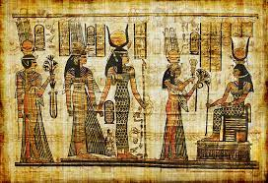
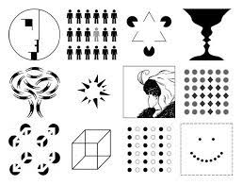
Syllabus
Unit 1: Historical Background and Basics of Visual Communication
Topics- Concept and History of Visual Communication, Human Eye and Visual Process, Visual culture and Information Education Communication, Theories of visual communication - Gestalt Theory of visual communication, Perceptual theory of Visual communication, Semiotics and cognitive approach in visuals
Unit II: Theories of Visual Communication
Topics: Fundamentals of Design: Definition. Approaches to Design, Centrality of Design, Elements of Design, Principles of Visual and other Sensory Perceptions. Colour psychology and theory (some aspects), Definition, Optical / Visual Illusions, etc., Various stages of design process, Learning skills to read signs and signifier in visuals for social messaging

Slide 95
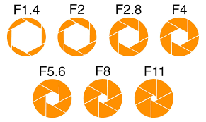
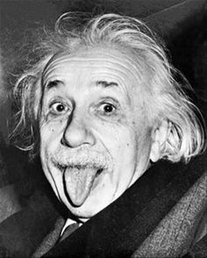
Unit III: Photography as Visual Communication
Topics: Introduction to photography, Camera – structure and function of camera , Characteristics of light, Sources of Light – Nature, Artificial and Available, Lighting techniques – three-point lighting, Exposure – focusing, aperture, shutter speed, Depth of field. , Kinds of light indoor and outdoor – Electronic flash and artificial lights, Light meters
Unit IV: Camera Compositions and Accessories
Topics: Camera lenses and accessories, Basic shots, angle, and view, Composition, Role of photographic image in visual communication, Basics of photojournalism, photo-features, photo - essays, writing captions, visual storytelling.

Slide 96
Evaluation
Continuous Assessment - 20 marks
End Term Practical/Written Exam - 40 marks
Viva - 20 marks

Slide 97
Job opportunities: Photographer, Graphic Designer, Web Designer, Advertising and marketing specialist, photojournalist and many more..
Enhanced visual literacy enabling you to interpret and create visuals with greater meaning and impact
Benefits
Skill to create captivating content for social media and craft visually compelling presentations for college assignments and future professional endevours
Artistic expression and creative problem-solving through visual designs and photography in personal and professional scenarios

Slide 98
Creative Writing
Skill Enhancement Course (SEC)
Department of English
Daulat Ram College, University of Delhi

Slide 99
Course Objective
To build creative writing skills of students in the main modes of creative writing viz poetry, fiction (novel, short stories), non-fiction (life narratives, autobiographies and biographies) and drama.
To inculcate practical skills in students by mapping their creative talent which be beneficial for employability too.
To perform hands-on-activities to students to develop their creative skills through practical sessions.

Slide 100
Learning Outcomes
To be sensitive to the texture of literary language.
To develop craft in creative writing.
To be able to develop sense of expression through poetry/short story/biography.
To develop an understanding of the relationship between an individual and society.
To develop an understanding of theatre and performance through drama will also help them to develop observatory and behavioural skills.
To develop a critical thought process
Skills: Editing, Proof-reading, formulation of draft (s) etc.

Slide 101
UNIT- I
Introduction to Creative Writing- Meaning, Importance
Imagination & Writing- Peer-interaction, Activities on Imagination
Tropes, Motifs and Figures- Learning tropes, motifs and figuresthrough videos, Discussion on the findings
Craft of Writing- Figure of Speech, Word Play, Character Creation
Character Creation- Dialogue Enaction, Learning Characters through discussion on famous writings, Character Analysis, Writing activities on creating different types of characters (gender/social background/ethnicity etc.)

Slide 102
UNIT II
Close Reading
Analysis and Interpretation- Reading different works in Literature, Discussion in small groups, Practice Writing Session
Proofreading & Editing- Practice sessions on Proofreading & Editing of different types of writing

Slide 103
UNIT III
• Steps of Creative Writing- Pre-Writing, Writing, Post-Writing/Final Draft
Types of Creative Writing- Poetry, Fiction, Non-Fiction (Life Narratives), Drama
Creative Writing & Media- Film Review, Book Review, Other Writings in Media, Submission, Publication
Learning to write Poetry- Reading & understanding Poetry; Practising tone, rhyme, metre, verses; Writing sessions
Learning to write Fiction- Reading & understanding Fiction; Practicing different elements of fiction (Short story, Novella, Novel); Writing sessions
Learning to write Non-Fiction- Reading & understanding Non-Fiction (Biographies & Autobiographies); Practicing different elements of non-fiction; Writing sessions
Learning to write Drama- Reading & understanding Drama; Practicing different elements (plot, character, climax, verbal & non-verbal cues) of Drama; Writing sessions
Submission & Publication (in Print & Digital) - Discussions over how & where to submit and publish (online/offline), Hands-on activities

Slide 104
EVALUATION
CONTINUOUS ASSESSMENT- 20 MARKS
WRITTEN/PRACTICAL EXAM- 40 MARKS
VIVA VOCE- 20 MARKS

Slide 105
Benefits of Creative Writing:
Creativity helps one in excelling in all fields and careers.
The Art of Articulation is a skill integral to our career advancement.
Learn how to Structure your Imagination and Express yourself Cohesively.
Observing the World through your Mind’s Eye can take you places!
An important Aid to Enhancing you Emotional Intelligence.
Possible Career Paths: Writers/Poets/Dramatists, Editors, Proof-Readers, Literary Agents, Creative Developers (Advertisement, Business Proposals), Virtual Artists, Social-Media Influencers, Content Creators, Social Platform Developers etc.

Slide 106
“The world is full of magic things, patiently waiting for our senses to grow sharper.”
W.B. Yeats

Slide 107
Skills Enhancement Course- Public Speaking in English Language and Leadership
2 Credits Paper
80 Marks: 20 Marks- Continuous Evaluation
40 Marks- Practical Exam
20 Marks- Viva Voce
Daulat Ram College, University of Delhi

Slide 108
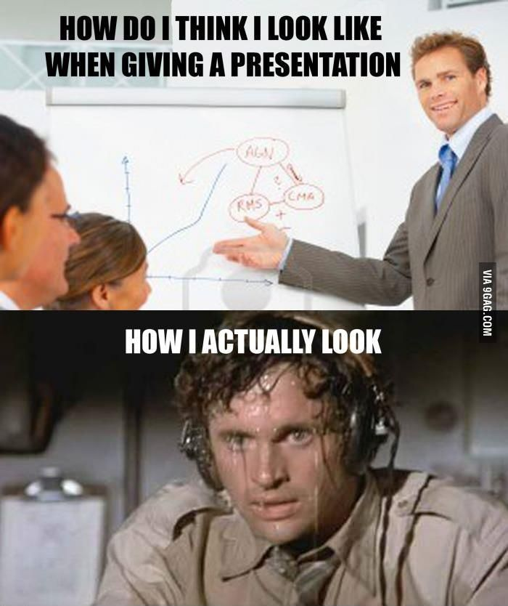
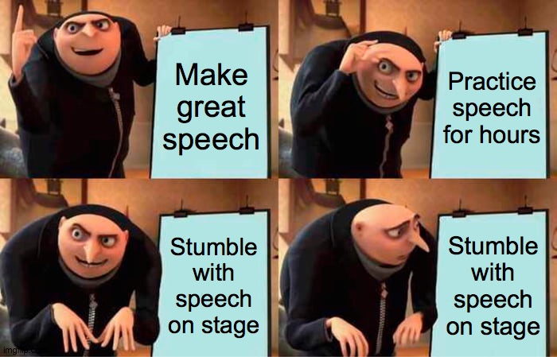
Why PSELL?
Humans are social animals
Builds Confidence
Personality Development
Attaining Fluency in English language
Encourages Leadership qualities
Learning Multiple Skills through one paper
Instils Teamwork

Slide 109
Syllabus:

Slide 110
Learning through Activities:
Group Discussions
Turncoat Events
Campaigns
Public Speeches
Pictionary
Introduction Sessions
Structuring Speeches
Word associations
And many more…

Slide 111
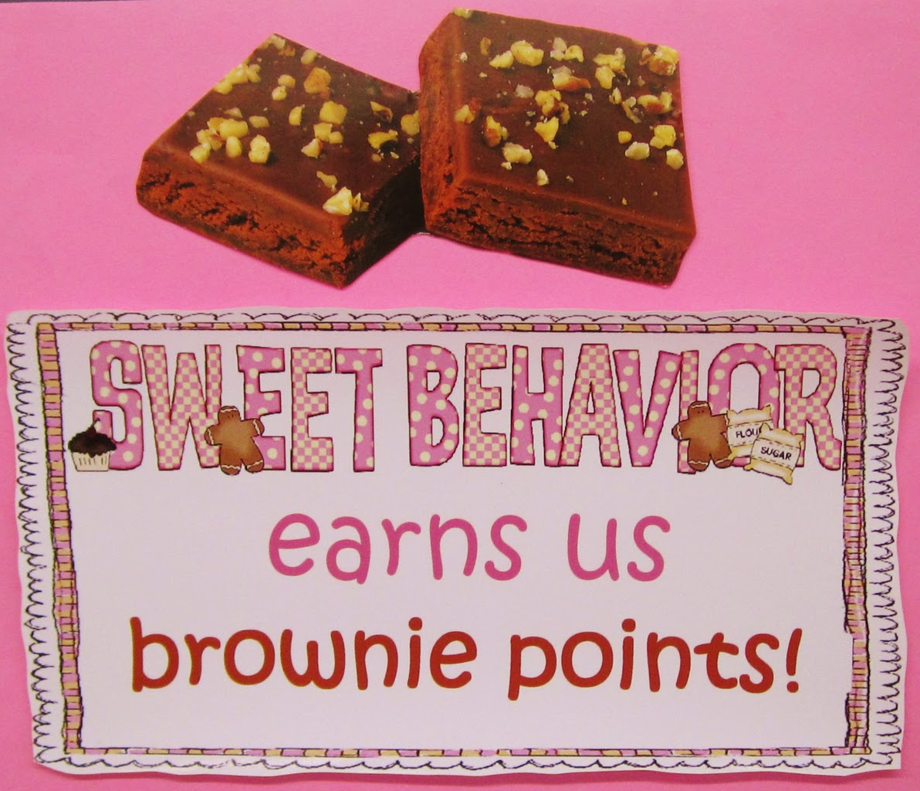
Pattern of Assessment for Continuous Assessment (20 Marks)
The first few classes will be introduction to the paper and understanding the basics of PSELL.
Subsequently, each class will have 1 activity that will be graded out of 5 marks.
Students need to necessarily participate in 4 activities to complete their 20 marks grading.
They can participate in more and the Best 4 marks will be taken into account.
Attendance does not carry marks but regular students will be given brownie points in the end of the Semester.

Slide 112
Practical (40 marks) and Viva (20 Marks):
These two components form 60 Marks out of 80 Marks for this paper.
They will be conducted together and an External Examiner will be called to conduct your Viva.
If any student misses both these components, they will fail.
Practical Exam will be in a written format while Viva Voce will be oral.

Slide 113
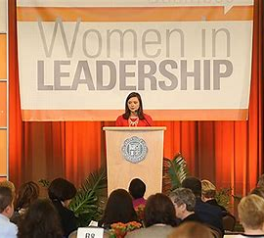
A community whose voice has been confined to private spaces for centuries, a community whose voice is not viewed as ‘impactful’ or ‘informed’ or ‘rational’ enough, this paper offers an opportunity for you to learn how to present that insightful, holistic, and impactful voice of yours to the public sphere.
Let us help you become adept at Public Speaking and become Leaders who are not afraid to voice their opinions, concerns, and ideas; who help others achieve their goals; and who are cognizant of the ethical aspect of leadership, public speaking, and human existence.

Slide 115
Skill enhancement Course: Communication in Professional Life
2 Credits Paper(2 P)
80 Marks
Continuous Assessment
(20 Marks)
Viva Voice
(20 Marks)
Practical/Written Exam
(40 Marks)
Presented by-
Ms Suman
Assistant Professor
Department of English
Daulat Ram College
University of Delhi

Slide 116
Learning Objectives
To prepare students for their upcoming Professional fields.
To inculcate the fundamentals of Professional and business communication.
To learn aspects of global communication.
To enhance employability skills of the learners by enabling them to write effective Resume and face Interviews with Confidence.

Slide 117
Syllabus
Theory
UNIT 1
Theory of Business Communication (1 hr.) - • Introduction • What is Business Communication? • Language of Business Communication • Cultural Components – Cross-Cultural Communication, Cultural Shock, Stereotyping, Ethnocentrism • Miscommunication & Effective Communication (1hr.)
UNIT 2
Listening Skills (5 hrs.) • Netiquettes (1 hr.) • Audio-book Listening & Discussions (3 hrs.) • Note-taking (1 hr.)
Unit-3
Speaking Skills: • Presentation Skills- Oral Presentation, Ppt. Preparation, Ppt. Presentation (3 hrs.) • Group Discussion (3 hrs.) • Talks- Domain-specific, Ted-Talks, Business Meets, Motivational Talks (2 hrs.) • Telephonic Skills (1 hr.) • Persuasion Skills (1 hr.) • Meeting & Negotiation (1 hr.) • Interview- Promotion Interview, Job Interview, Business Interview (2 hrs.) • Functions and activities of PR (1 hr.)
Unit4
Writing Skills
• Summarising & Paraphrasing (1 hr.) • Job-Oriented Skills- CV, Resume & Bio- Data, Job Application Letter (1hr.) • Documentation (1) • Advertisements & Invitation (1 hr.) • Letter Writing- Applications, Business Letters (1 hr.) • Report- Analytical Report, Project Report (1 hr.) Digital Communication in Social Space- Social Media Posts (Twitter, Facebook), Blog Writing, Review Writing (2 hrs.) • Advertisement/Invitation/Poster Designing- Canva/MS Word/Coral (1 hr.) • Memo, Office Order, Minutes (1 hr.) • Making Online Academic/Work Profile- LinkedIn (1 hr.)

Slide 118
Activities
Group Discussion
Presentation
Interview
Debate Competition
Public Speeches
Book Review
Movie Review
Report Writing

Slide 119
Learning Outcomes
Improve presentation skills by effective use of verbal and non-verbal communication for the professional field.
Acquire practical employability skills to be disseminated through focused sessions on practical employable knowledge.
Students will be able to enhance professional communication.
Improve persuasion and negotiation skills which will be useful for the professional field.

Slide 121
Daulat Ram College
Skill Enhancement Course
Communication in Everyday Life (CEL)

Slide 122
Orientation Plan
Information about Communication in Everyday life
Course Content
Course Objectives
Learning Outcomes
Evaluation Criteria

Slide 123
Course Content
What is Communication
3 Forms of Communication
Written, Oral, Sign Language
Use of the forms in Everyday Life- Oral and Written
Four skills- Listening, Speaking, Reading, Writing

Slide 124
Course Objectives
At the end of the course, students will be able to:
Effectively communicate with confidence
Understand and Use Communicative Language Teaching (CLT)
Smoothly transit from monologue to dialogue to multilogue (Group Discussion)

Slide 125
Learning Outcomes
Develop speaking skills through listening skills
Enhance writing skills through reading skills
Develop intra and inter personal speaking skills
Communicate opinions politely and firmly
Communicate in formal and informal everyday environment
Enhance cooperative learning through group discussions
Understand the importance of peer group interaction

Slide 126
Evaluation Criteria
Continuous Assessment with LSRW – 20 Marks
End Semester Practical Assessment – 60 Marks
Internal Assessment (Oral & Written) – 40 Marks
External Assessment (Viva) – 20 Marks

Slide 127
Thank you
R. Rajeshwari

Slide 128
Department Hindi

Slide 129
SEC
रंगमंच
2066000002

Slide 130
इकाई - 1
भरतमुनि का नाट्यशास्त्र
(संक्षिप्त परिचय)
हिन्दी का पारम्परिक रंगमंच
(संक्षिप्त परिचय)

Slide 131
इकाई - 2 प्रस्तुती प्रक्रिया
आलेख का चयन
अभिनेताओं का चयन
दृश्य परिकल्पना (ध्वनि, संगीत, नृत्य, प्रकाश इत्यादि)
पूर्वाभ्यास

Slide 132
इकाई - 3 अभिनय की तैयारी
वाचिक
आंगिक
आहार्य
सात्त्विक

Slide 133
इकाई 4
आशु अभिनय
थियेटर गेम्स
संवाद-वाचन
शारीरिक अभ्यास
सीन वर्क

Slide 134
इकाई 5- मंच प्रबन्धन
सेट
रंगसामग्री
प्रचार-प्रसार
ब्रोशर निर्माण

Slide 135
॥ धन्यवाद ॥
डॉ. अविनाश कुमार मिश्रा
सहायकाचार्य, हिन्दी
दौलतराम महाविद्यालय,
दिल्ली विश्वविद्यालय

Slide 136
Department Maths

Slide 137
Skill Enhancement Course (SEC) UGCF-2022 IT Skills and Data Analysis-I
Date: 22 August 2023
Dr. Poonam Lakhotia
Assistant Professor
Daulat Ram College
University of Delhi
s licensed under BY-

Slide 138
Learning Objectives
Familiarize the student with the quantitative skills required for representing and interpreting data for the purpose of decision making.
Equip the student with some fundamental concepts, which play a critical role in understanding and visualizing real world data.
Enable the student to analyze data and problem situations using relevant IT tools.

Slide 139
Learning Outcomes
Represent and interpret data in tabular and graphical forms.
Understand and interpret the measures of central tendency and dispersion.
Use IT tools such as spreadsheets to visualize and analyze data.

Slide 140
CREDIT DISTRIBUTION, ELIGIBILITY AND PRE-REQUISITES OF THE COURSE
Course | Total Credits | Components | Eligibility criteria | Pre-requisite of the course
 |  | Practical
IT Skills & Data Analysis-I | 2 | 4 | Nil | Nil

Slide 141
IT Skills & Data Analysis-II
Extension of the course IT SKILLS & DATA ANALYSIS-I.
Students will learn about advanced skills of analyzing data
for the purpose of decision making.
Use of advanced features in spreadsheets to visualize and analyze data.

Slide 143
Department Music

Slide 144
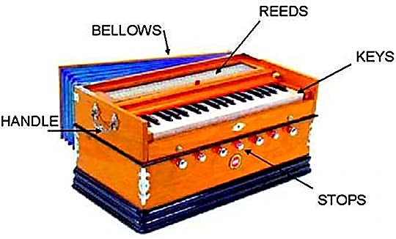
SKILL ENHANCEMENT COURSE HARMONIUM

Slide 145
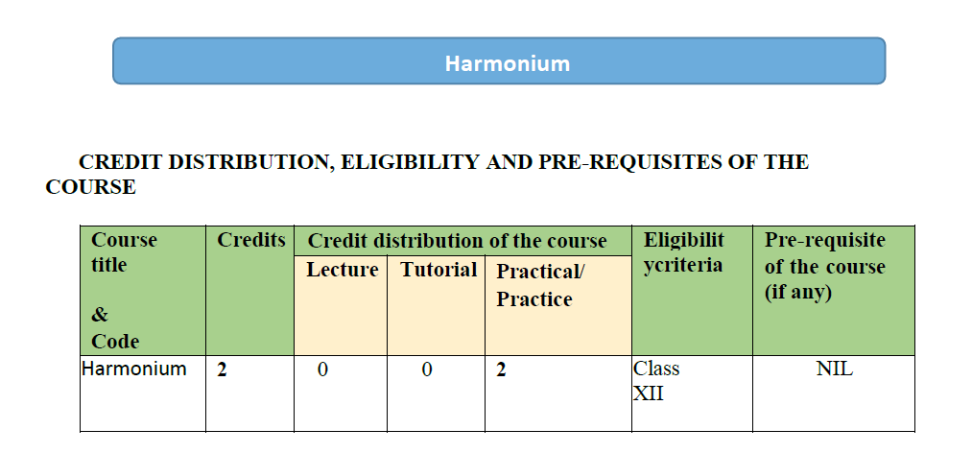

Slide 146
Learning Objectives The Learning Objectives of this course are as follows: ● To initiate the students to a very popular instrument of Indian music through a general discussion on the role of Harmonium in accompanying various singing forms ● To throw light on the various types of musical instruments that are played in Hindustani music ● To discuss the features of various types of wind instruments ● To teach the student the fundamentals of playing the Harmonium, such as the correct placement of the fingers on the instrument, the right posture for sitting etc. ● To demonstrate tonal exercises, such as palta-s and alankar-s, vital for playing. ● To initiate his training in the realm of playing the instrument with the basic ragas, like Alhaiya, Bilawal and Yaman

Slide 147
Learning outcomes
The Learning Outcomes of this course are as follows:
● After studying this course, students will be able to learn the origin,
development and classification of musical instruments.
● After studying this course, students will be able to learn the
importance of wind instruments.
● After studying this course, students will be able to learn gat and dhun
in prescribed ragas.
● After studying this course, students will be able to demonstrate the
various talas and their layakaries.
● After studying this course, students will become well-versed with the
techniques of playing HarmoniumAfter studying this course, students will be able to achieve dexterity of
the hand, through regular practice of the playing exercises at home.
● After studying this course, students will be able to read and learn new
compositions in the prescribed ragas.
● After studying this course, students will be able to grasp the various
grammatical aspects of the prescribed ragas, like how they arise, what are the
respective rules that govern these ragas, how do the notes move in the ragas,
what are the performing times of the ragas etc.
● After studying this course, students will be able to learn the art of playing
a raga, especially with regard to having the Tabla as an accompanying
instrument.

Slide 148
Department physics

Slide 149
Skill Enhancement Courses
Physics Department
1. PCB Designing and Fabrication
2. Electronic Product Testing
3. Analytics/Computing with Python
4. Essentials of Python
5. Programming with Python
6. Document Preparation and Presentation Software
7. Radiation Safety

Slide 150
PCB Designing and Fabrication
SEC Paper (2-credits)

Slide 151
ELIGIBILITY
12th with any stream
TARGET AUDIENCE
Students of all streams
Science
Commerce
Humanities

Slide 152
LEARNING OBJECTIVES
A comprehensive understanding and hands-on exposure to various processes, industrial tools, protocols, design specifics which are involved in PCB Designing.
Students can design an electronic printed circuit board (PCB) for a specific application using industry-standard software.
Familiarization of various types of devices/components that may be mounted on PCB.
Understanding of the PCB layout techniques for optimized component density and power saving.
Understanding of the current trends and scope of the PCB industry.

Slide 153
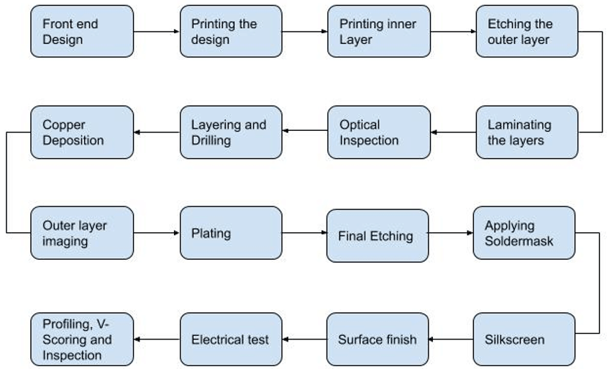
Steps involved in PCB Designing

Slide 154
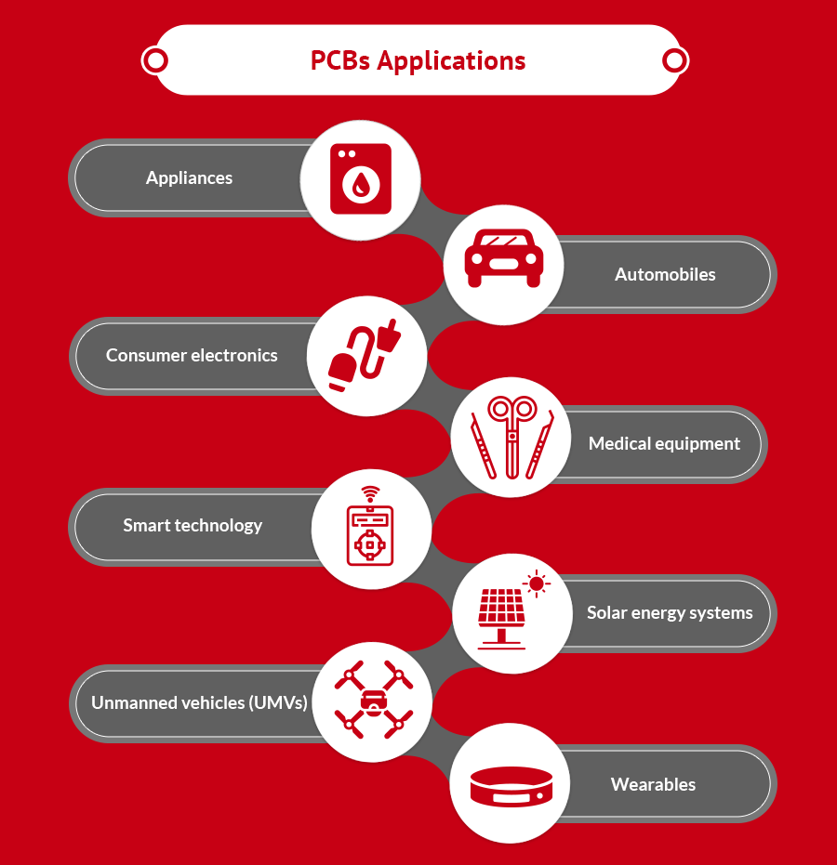
PCB Designing Applications

Slide 155
Electronic Product Testing
SEC Paper (2-credits)

Slide 156
ELIGIBILITY
12th with any stream
TARGET AUDIENCE
Students of all streams
Science
Commerce
Humanities

Slide 157
LEARNING OBJECTIVES
To enable students for testing of various electronic and electrical components and instruments.
Practice soldering and de-soldering processes with correct methods.
Students will have insight knowledge of SMPS, UPS and batteries along with maintenance of consumer electronics gadgets like computers, Audio Amplifiers, Induction Top, Solar Panel etc.
Capable of assembling, fault diagnosis and rectification in a systematic way.

Slide 158
Electronic Product Testing Applications
Has a vast applications in industries involving electronic products.
The emerging technologies such as Artificial intelligence (AI) increases the possiblities for the testing market.
The testing market will projected to a value of USD 2.4 billion by 2024.

Slide 159
Python
( Skill Enhancement Course )
SEC Courses Available on Python In DRC:
Python SEC-1: Analytics/Computing with Python
Python SEC-2: Essentials of Python
Python SEC-3: Programming with Python

Slide 160
What is Python?
What is Python?
What is Python ?
Python: A computer programming language often used for data analysis , to build websites & softwares and automate various tasks.
One of the most popular programming language in recent years.
Platform independent code.

Slide 161
What is Python?
What is Python?
What is Python ?
Extremely versatile language.
Syntax is clear, easy to read and learn (beginner friendly);
Open source software
Simply extendable via C/C++, wrapping of C/C++ libraries.
Comprehensive standard library for many tasks.
Large and active community.

Slide 162
Python SECs : Objective and Eligibility
Objective of Courses
Learn basic program -solving Techniques using Computers
Develop logical thinking ability to propose novel solutions for real world problems through programming.
Deepen the empirical knowledge on applying programming on business domains

Slide 163
What is Python?
What is Python?

Slide 164
Document Preparation and Presentation Software - LaTeX
( Skill Enhancement Course )
What is LaTeX?
LaTeX is a document preparation system for high-quality typesetting.
LaTeX is most often used to produce technical or scientific documents, but it can be used for almost any form of publishing.

Slide 165
Why LaTeX?
Modification in big documents is easy
Separation of content and style
Portability
Open source
Page numbers auto
Generates list
Scientific features

Slide 166
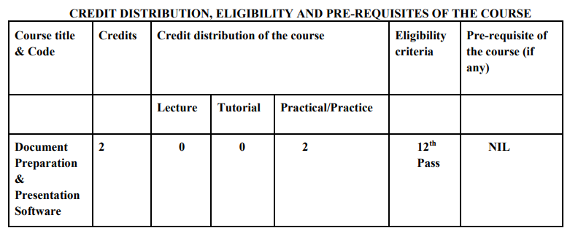
LaTeX SEC: Objective and Eligibility
Objective of Courses
Develop proficiency in the use of document preparation software such as document LaTeX
Make a presentation using LaTeX
Serve as a tool for conveying/communicating one's ideas, views, and observations.

Slide 167
What is Python?
LaTeX SEC - Document Preparation and Presentation Software
Learning outcomes:
Incorporate well-formatted mathematical equations, algorithms, figures, tables and references in a document.
Make a presentation.
Able to add bibliography/references to a document and cite them easily wherever required in document.
Handle basic aspects of document structure, including sections, subsections, paragraphs, and bulleted and enumerated lists.

Slide 168
Offline use:
Install MikTex
Install Editor – TexMaker / TeXstudio
Online use:
Create account on overleaf

Slide 169
Radiation Safety
(Skill Enhancement Course)
offered by
Department of Physics
Daulat Ram College

Slide 170
Different types of radiations
Radiation may be non-ionizing – UV, visible, IR, microwaves, radio waves, thermal (heat) etc.
Radiation may be ionizing – X-rays, gamma rays, alpha particles, beta particles, gamma rays, neutrons etc.

Slide 171
Do we really use radiation?
Lots of Industrial applications
Food preservation
Sterilization of health care product
Irradiation of blood to prevent transfusion
Sterilization of tissue for transplant surgery
Synthesis of radiation-cured rubber
Manufacture of radiation-cured wood polymer composites

Slide 172
Why is this paper important?
Radiation Safety is a concern for patients and staff in many medical departments and food industry.
Understanding Radiation Safety opens job options in government and non-government sectors, immediately after post graduation.

Slide 173
Who can study Radiation Safety as an SEC paper at undergraduate level?
Students who have studied Physics and Mathematics in class XII
How can it lead to job?
After studying this paper, students can get an idea of what is all about and whether they can pursue a career in it.

Slide 174
Eligibility to become a Radiological Safety Officer:
Bachelor of Sciences (in any stream)
Master of Sciences (in any stream)
Certificate course from Institutes recognized under Atomic Energy Regulatory Board (AERB)
R.P. & A.D. (Bhabha Atomic Research Centre)
Amity Institute of Nuclear Science & Technology https://www.aerb.gov.in/english/rso-training

Slide 175
List of Certificate Courses in Radiation Safety
Radiological Physics and Advisory Division (RP&AD) of BARC conducts following RSO courses: (https://www.aerb.gov.in/english/rso-training)
Radiological Safety Officer (Radiotherapy) Certification Examination
Radiological Safety Officer (Nuclear Medicine) Certification Examination
Training cum RSO certification course on Radiation Safety Aspects of Gamma Irradiation Chamber
Training cum RSO certification course for Operation of Radiation Processing Facilities(Gamma and Electron) for Food, Healthcare and Allied Products
Training course on Safety Aspects in the Research Applications of Ionising Radiation
Training cum RSO certification course on Radiation Safety Aspects of Nucleonic Gauge

Slide 176
Radiation Safety paper is a good SEC option for the students of:
B.Sc. (H) Physics
B.Sc. (H) Zoology
B.Sc. (H) Biochemistry
B.Sc. (H) Botany
B.Sc. (H) Chemistry
B.Sc. (Life Sciences)

Slide 177
So go ahead…….

Slide 178
Department political science

Slide 179
Skill Enhancement Course
Negotiations and Leadership

Slide 180
Introduction
This paper has Two credits and is a practical paper.
It will introduce the students to the importance of negotiations skills
It will expose the students to diverse contexts and situations that require negotiations and leadership skills.

Slide 181
Students will learn about the management of critical and crisis situations.
Students will learn how to evolve relationship building skills.

Slide 182
Learning outcomes of this course
After studying this course, students will be able to apply negotiation skills to obtain desired results.
Students will be able to understand the various aspects of a crisis situations for appropriate management.
Students will be able to learn how to manage complex negotiation situations.

Slide 183
Students will be able to understand the process of relationship building
Students will be able to test and judge the legitimacy of the terms of negotiations.

Slide 184
Thankyou

Slide 185
Political Leadership and Communication
Skill Enhancement Course - Political Science (Sem 1)
Dr. Piyush Kant
Department of Political Science
Daulat Ram College, University of Delhi

Slide 186
Course Objective
To understand the cross-cutting multi-disciplinary linkage of the subject.
To gain a basic understanding of specific concepts and critical review of political communication and election campaign studies.
To be able to construct a linkage between political communication and leadership.
To learn conceptual frameworks and qualitative research skills for the analysis of modes and techniques of political communication and leadership.

Slide 187
Syllabus
Unit I: Explaining Political Communication
Unit II: Exploring Leadership
Unit III: Expanding Political Communication and Leadership: Orientation and Action
Unit IV: Extending Political Communication and Leadership: Research Issues and Challenges
Unit V: Executing Political Communication and Leadership: Empirical and Professional Implications

Slide 188
Course Learning Outcomes
On successful completion of the course, students would be able to have a professional/career oriented insight by facilitating their journey
as media managers, policy makers,
political analysts, journalists,
public relation officers in government agencies, political parties and higher education.

Slide 189
Thank you!

Slide 190
Department Zoology

Slide 191
Aquaculture Enterpreneurship
SEC PAPER OFFERED BY DEPARTMENT OF ZOOLOGY
SEMESTER-1

Slide 192
Introduction
This paper offers following learning opportunities to the students
To give first hand training on traditional and modern aquaculture practices.
To understand variety of aquaculture crops and their requirements.
To understand the technique required for management of aquaculture ponds .
To learn the water quality management for optimum fish production systems.
To understand variety of methods to enhance the aquacrops and increase its productivity .
It's an important paper to understand the basics of next paper offered in Semester 2 ie Ornamental fish culture .
Gives hands on training in fish handling.

Slide 193
Learning outcomes
By the end of the course students will be well versed with:
Understanding of sustainable aquaculture farms.
To be able to identify profitable and economical aquaculture crops.
To understand the role of aquaculture in nutrition security, poverty elevation and employment generation.
Students get a wide knowledge of aquaculture related businesses like Prawn and fish farm
Students can start their own enterprise.

Slide 194
Target audience
Any students who has keen interest in:
Fish and Aquatic animals.
Who wants employment opportunities in this sector.
Wants to have first hand experience in fish handling and understanding.
Wants to build a skill in fish biology ,it's a base paper for further papers offered in Next semesters (SEMESTER-2 -ornamental fish culture,SEMESTER-3 -formulation of fish feed SEMESTER-4, Fish breeding and larviculture

Slide 195
Eligibility
Student should be enrolled for first year undergraduate course in Delhi University

Slide 196
THANK YOU

